Slide 1
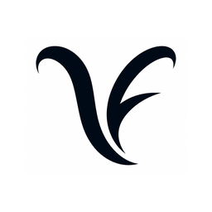
OPEN
Light load — everything gets through
KungFlow
Focus that protects your people.
LEARNING
Load rising — KungFlow is watching your back
KungFlow senses cognitive overload in real time and quietly blocks
interruptions — automatically. Healthier minds, deeper work.
PROTECTED
Overload — interruptions quietly blocked
Seed Round · 2026
Ido Mark · Rotem Saraf · Eden Elkayam

Slide 2
THE TEAM
Built by people who lived the problem
IM
RS
EE
Ido Mark
Rotem Saraf
Eden Elkayam
Computer Science
Computer Science
Computer Science
Engineering
Engineering
Engineering
Why us? This problem sits exactly between attention, wellbeing, and software engineering - and so do we. We built KungFlow because notifications were burning our own working hours.
2

Slide 3
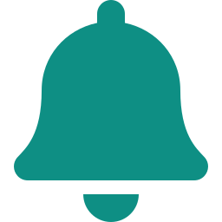
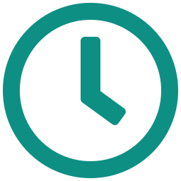

THE PROBLEM
You're in the zone — then the pings hit
56
23 min
Stress up
interruptions per workday
to regain deep focus
the hidden price of pings
Pings, messages and alerts — one every ~9 minutes
After every single interruption (Mark, UC Irvine)
Interrupted work raises stress, frustration & time pressure (CHI '08)
Feel that for a second — your focus shattering. Now multiply it across every employee. That's what it costs the company.
3

Slide 4
THE COST
It costs people. Then it costs money.
THE HUMAN COST
THE BUSINESS COST — 250-PERSON COMPANY
26% higher stress and lower job satisfaction among employees with more digital interruptions (Microsoft)
12B working days lost globally every year to depression & anxiety — a $1T productivity bill (WHO)
$30M total payroll for 250 employees, every year
~5% of it — $1.5M+ — lost to interruptions (~2 hrs per person, daily)
Chronic interruption load is a direct driver of workplace stress and burnout.
Salary $10K gross/mo · employer cost ~$75/hr — money you already spend.
The good news: wellbeing pays. Every $1 invested in employee mental health returns ~$4 in health and productivity (WHO).
4

Slide 5

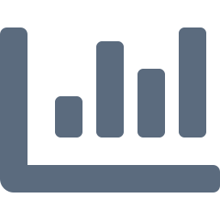
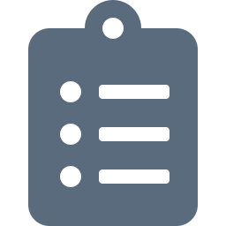

THE GAP
Plenty of fixes. None act in time.
Manual Do-Not-Disturb
THE GAP
Asks an overloaded brain to notice it's overloaded — exactly when it can't.
No tool detects overload and acts on it — automatically, in real time, with zero effort from the employee.
Time trackers (RescueTime, Toggl)
Report the damage after it's done. A speedometer, not a seatbelt.
Company focus-hour policies
One-size-fits-none. Not personal, not enforced, quietly resented.
Wellness apps (Calm, Headspace)
That's the product we built.
Lovely — but they live outside the workflow where the damage happens.
5

Slide 6




THE SOLUTION
KungFlow — a firewall for your focus
1 · SENSE
2 · UNDERSTAND
3 · PROTECT
Reads behavioral rhythm only — typing speed, window switches, mouse motion. Every minute, silently.
Scores cognitive load against your personal baseline. It learns what “normal” means for you.
Load exceeds 125% of baseline? DND on, WhatsApp & Outlook muted. Load drops? Everything back. Automatically.
No buttons. No willpower. No new habits. The employee just works — KungFlow guards the door. Desktop agent (Windows) + Chrome extension, live today.
6

Slide 7
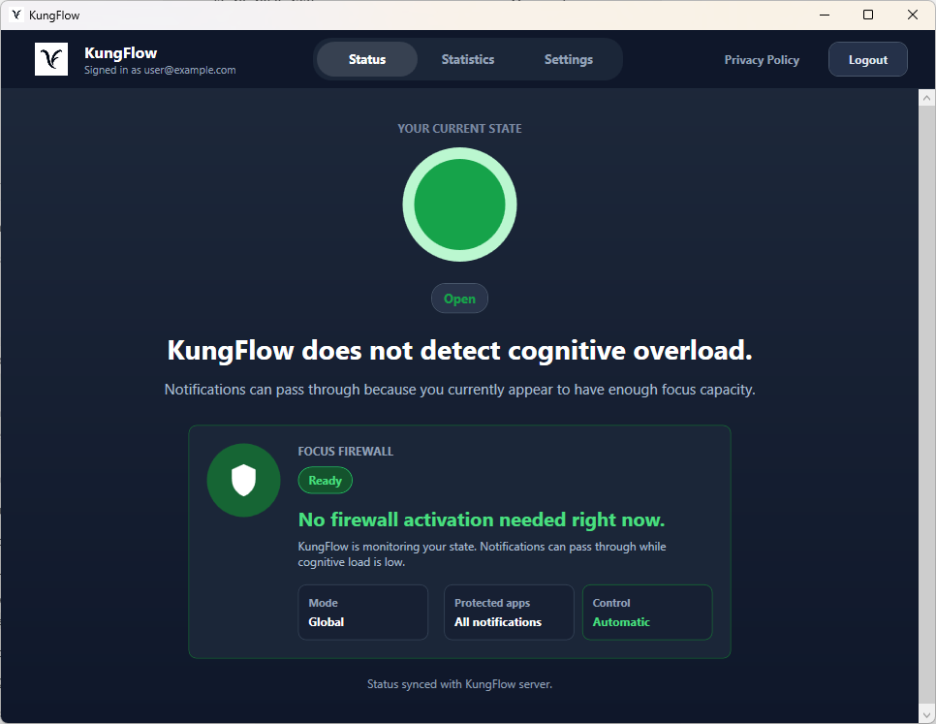
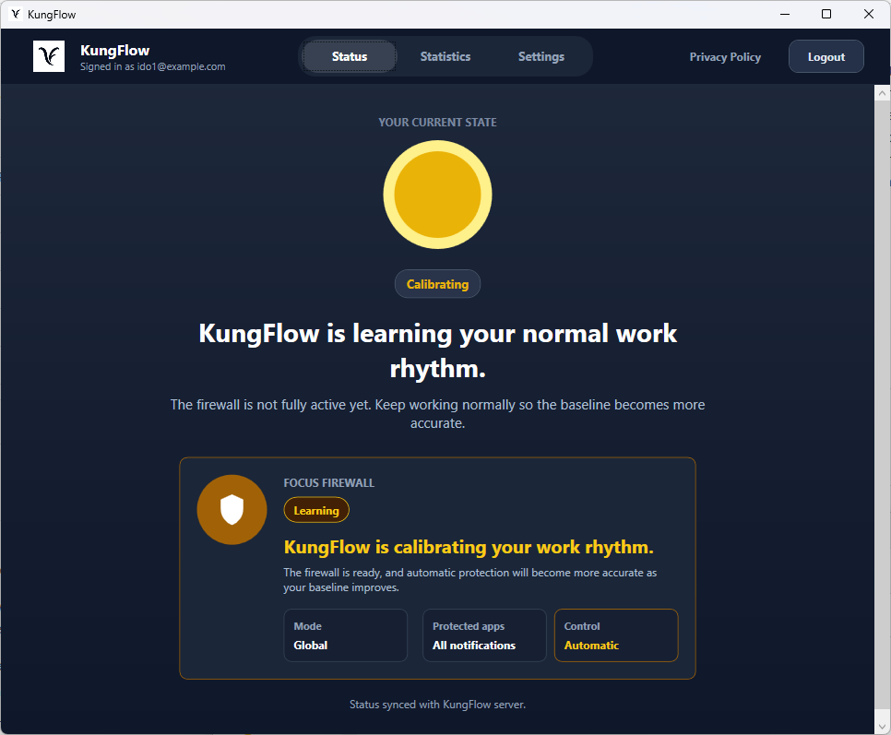
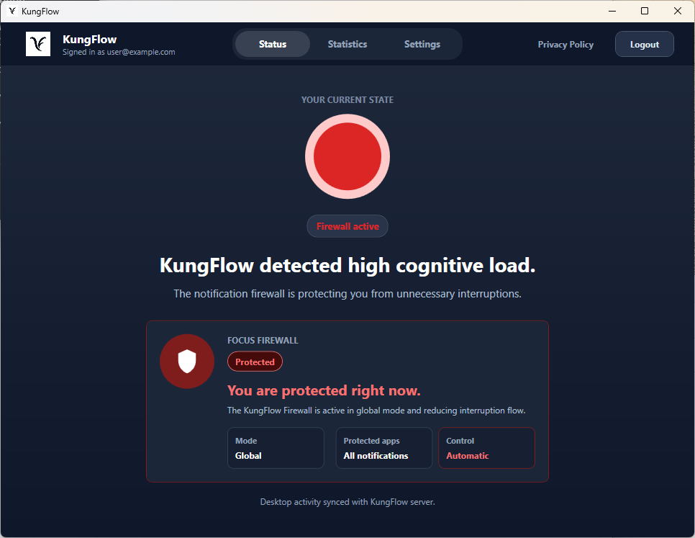
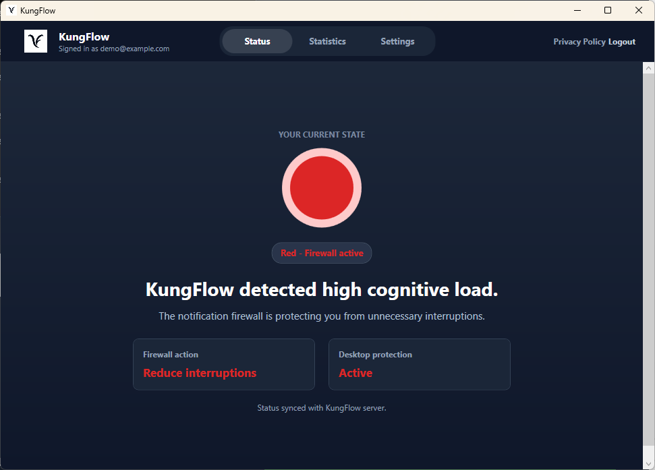
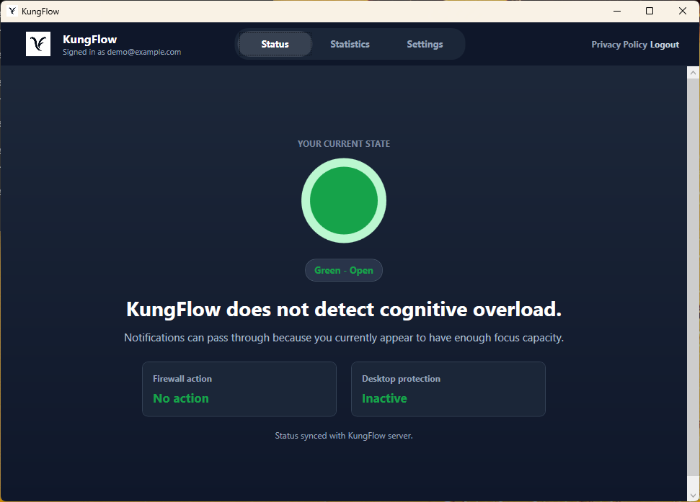
THE PRODUCT
Live Windows protection states
Open state
Calibrating
Firewall active
Low cognitive load: notifications can pass through.
KungFlow is learning the user baseline before full automation.
High load detected: the notification firewall protects focus.
A simple status experience makes the firewall visible: open when focus is stable, learning while calibrating, protected under high load.
7

Slide 8

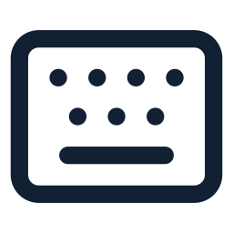

HOW WE DO IT
Behavioral metadata becomes a load score
Mouse movement
Typing behavior
App switching
Speed, acceleration, and micro-pauses help detect rising stress during real work.
Typing rhythm, pace changes, and delete/backspace use reveal friction without storing content.
Window switching and visible app count show context switching and attention fragmentation.
Score = weighted behavior signals compared with the user baseline
When current load rises above the adaptive baseline, KungFlow activates the firewall. Only behavioral metadata is stored - never typed content, screenshots, documents, or websites.
8

Slide 9

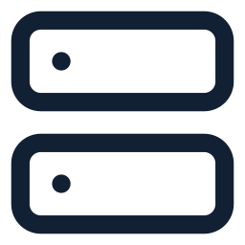
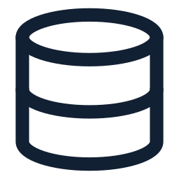
ARCHITECTURE
How did we build it?
A lightweight client-server loop connects the Windows agent, the scoring backend, and SQL storage.
Desktop Agent
PROTECTION DECISION
KungFlow Server
SQL Database
Collects behavioral rhythm on Windows: mouse movement, typing pace, active windows, and app switching.
Receives activity samples, authenticates users, scores current load against the personal baseline, and returns a protection decision.
Stores users, sessions, behavioral samples, baseline state, and firewall activation events.
ACTIVITY SAMPLE
METRICS + BASELINE
C#
.NET
Windows
Node.js
Express
API
Users
Metrics
Baseline
The agent never sends content. It sends metadata samples, the server computes state, and the firewall decision returns to the desktop in real time.
9

Slide 10


TRUST BY DESIGN
Not surveillance. The opposite.
KUNGFLOW NEVER SEES
56% vs 40%
of digitally monitored employees feel tense or stressed at work, compared to non-monitored peers (APA, Work in America 2023).
What you type
Websites you visit
Documents you open
Screenshots — of anything, ever
IT ONLY SENSES RHYTHM
Typing speed & window switches — signals your OS already has
Surveillance backfires. So we flipped the model: the data belongs to the employee and works for the employee. KungFlow is a perk, not a watchdog.
All signals are anonymized and aggregated — managers see team trends only, never an individual's score.
Every employee can pause data collection. One toggle, no questions.
10

Slide 11
VALIDATION
We tested it. Focus won.
Task accuracy — error-correction task, score out of 20
+165%
better task scores once interruptions were removed
49%
fewer errors missed in the same 10-minute window
+25%
net gain after controlling for natural learning effects
Controlled pilot, n=8, with a learning-effect control group (2026). Larger study planned with design partners.
11

Slide 12
IMPACT
The math for one 250-person company
$1.5M
$90K
16 : 1
vs
=
recovered at just 5% of payroll
for KungFlow — 0.3% of payroll, all 250 seats
return on every $1 spent — and you add no real spend
AND FOR EVERY SINGLE EMPLOYEE
~2 hrs
56 → quiet
Calmer days
of deep work back, daily
interruptions blocked at the right moment
less stress, lower burnout risk
12

Slide 13
MARKET
A big problem — and an empty category
TAM
SAM
SOM Y1
1.2B
400K
2,500
knowledge workers worldwide
tech workers in Israel — our beachhead
users across 10 mid-market companies
Acts automatically, in real time?
RescueTime
Calm for Business
MS Viva Insights
Built-in DND
KungFlow
reports after the fact
outside the workflow
org dashboards only
needs the user to act
detects & protects on its own
13

Slide 14
BUSINESS MODEL
SaaS that climbs the org chart
Free
Team
MOST POPULAR
Enterprise
Business
$0 forever
$20 /user/mo
$30 /user/mo
$45+ /user/mo
For individuals
Everything in Free, plus
Everything in Team, plus
Everything in Business, plus
• Live cognitive-load score
• Adaptive personal baseline
• Team focus analytics
• Org burnout-risk analytics
• Auto-DND · 1 device
• All apps + all devices
• Custom & VIP rules
• AI recap of missed pings
• 7-day focus history
• Unlimited history + dashboard
• Admin console + onboarding
• SSO/SAML · CSM + SLA
For individuals · real focus protection, free
The power user · it learns you & covers every app
The manager · a whole team in deep work, with visibility
HR + IT · org-wide rollout, security & support
Bottom-up by design: free individual → paid team → manager → org, no new sales motion. ACV $90K · LTV:CAC 11:1 · 3-yr retention
14

Slide 15
THE ASK
$770K seed — break-even in 12 months
USE OF FUNDS
YEAR-1 MILESTONES
R&D — Scale & v2 development
M3
2 design partners live, feeding real usage data
57%
Marketing
M4
First paying company — revenue starts
18%
Customer success
M6
First SDR hired, outbound machine running
12%
Sales (SDR from M6)
M9
Public case study with measured results
12%
Infrastructure
M12
10 companies · 2,500 users · $900K ARR · break-even
1%
Covers 12 months of operations ($550K deficit) + 3-month buffer. One goal: 10 mid-market companies.
15

Slide 16
GTM STRATEGY
Product-led growth: free spreads, value sells
1 · ADOPT
2 · CONVERT
3 · EXPAND
4 · STANDARDIZE
Free, bottom-up
Free → Team
Team → Business
→ Enterprise
Individuals install the free tier and get real focus value — zero friction, no buyer needed. It spreads desk to desk.
Power users self-upgrade for the adaptive baseline and all their apps. Pure self-serve — no salesperson in the loop.
Managers see their team already using it and buy team analytics, admin and custom rules. Light sales-assist.
HR and IT roll it out org-wide — SSO, burnout analytics, dedicated CSM. Top-down lands on bottom-up demand.
Free does the selling. The product expands itself up the org chart — low CAC, fast payback, and it compounds as every free user pulls the next one in.
16

Slide 17
GO-TO-MARKET
How we reach companies
PHASE 1 · M1–3
PHASE 2 · M4–6
PHASE 3 · M6–12
THEN
Design partners
Founder-led sales
Scale outbound
Expand outward
2 companies from our own network, installed free — in exchange for feedback and case-study rights.
We sell directly. LinkedIn outreach to VP R&D and VP People at Israeli tech, 100–500 employees.
First SDR at M6. 40 sequences/week. Public case study at M9 with measured results.
Land & expand inside each account, then US via Israeli logos with US offices, then Europe (GDPR).
Why Israel first: warm founder network, demanding early adopters, and short sales cycles keep CAC low — and Israeli logos open doors in the US.
17

Slide 18
Thank you.
Let's give people their focus back.
KungFlow · Ido Mark · idoomark23@gmail.com

